Slide 1
Introduction to Databases
ReDI School
Autumn 2025

Slide 2
What is this lesson about?
Today we introduce databases
We will talk about the following topics today
Databases … What they are? How many types do we have? when to use which?
Database Management System (DBMS).
SQL and SQLite as our first RDBMS and how to use it to create our first DB
What is SQL and how to use it to “interact” with our database
Create, Read, Update and Delete entries in a DB

Slide 3




Database (DB)
Databases are a collection of organized data stored in a format
They are an essential component for every application that has to persist information
Notes:
When you run a program or a script,

Slide 4


Database types
There are many types of databases based on the use-case
Relational databases
NoSQL databases (non-relational database)
Key-value databases
Document databases
Cloud databases
Object-oriented databases
…
Notes:
Cloud databases are databases that are accessible from over the internet (think firebase from google)
Object-oriented databases are ones in which data is represented as objects and classes. An object is an item, such as a name or phone number, while a class is a group of objects. Object-oriented databases are a type of relational database.

Slide 5

What kind of database should I use?
Take a moment to think which kind of database fit your needs
It isn’t SQL vs NoSQL databases
Look at the data modeling for various databases and compare it against the business model
Sometimes using multi-types of database within a solution is totally normal

Slide 6




Database Management System (DBMS)
DBMSs are the software component that interacts with the database
It is responsible for interacting with the database (i.e. creating,editing deleting data)
It also controls who can access the database and might do more to ensure reliability of data and efficiency of querying data.

Slide 7

Relational Databases Management System (RDBMS)
RDBMS are DBMS of relational databases

Slide 8
Which of the following is not a database type
Relational databases
Classes-oriented databases
Graph databases
Hierarchical databases

Slide 9
Checkpoint

Slide 10
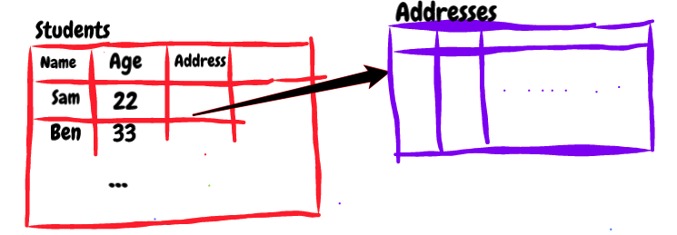

Relational Databases
They are a type of a database that are composed of tables and relationships between them.

Slide 11
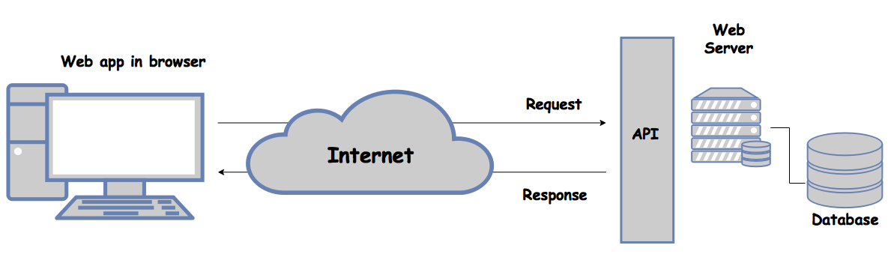
Architecture Overview

Slide 12
Understanding SQL (Structured Query Language)
Language used interact with most RDBM systems Declarative language - tell the system what you want, not how it should be done (similar to HTML/CSS from this perspective)
Declarative: “Give me the title of all PC games released this year”
Procedural: “For each game in games collection, if current game equals to current year, add title to the result, then return result”
Important: It is up to each RDBMS how it handles the query. This can lead to differences in syntax, capabilities and performance tuning between various RDBM systems (e.g.: Oracle, MySQL, MS SQL, SQLite, Postgres)

Slide 13
Understanding SQL
Commands within SQL are divided into several different types:
Data Definition Language (DDL): commands are also called data definition commands because they are used to define data tables.
Data Manipulation Language (DML): commands are used to manipulate data in existing tables by adding, changing or removing data. Unlike DDL commands that define how data is stored, DML commands operate in the tables defined with DDL commands.
Data Query Language (DQL): consists of just one command, SELECT, used to get specific data from tables. This command is sometimes grouped with the DML commands.
Data Control Language (DCL): commands are used to grant or revoke user access privileges.
Transaction Control Language(TCL): commands are used to change the state of some data , for example, to COMMIT transaction changes or to ROLLBACK transaction changes.

Slide 14
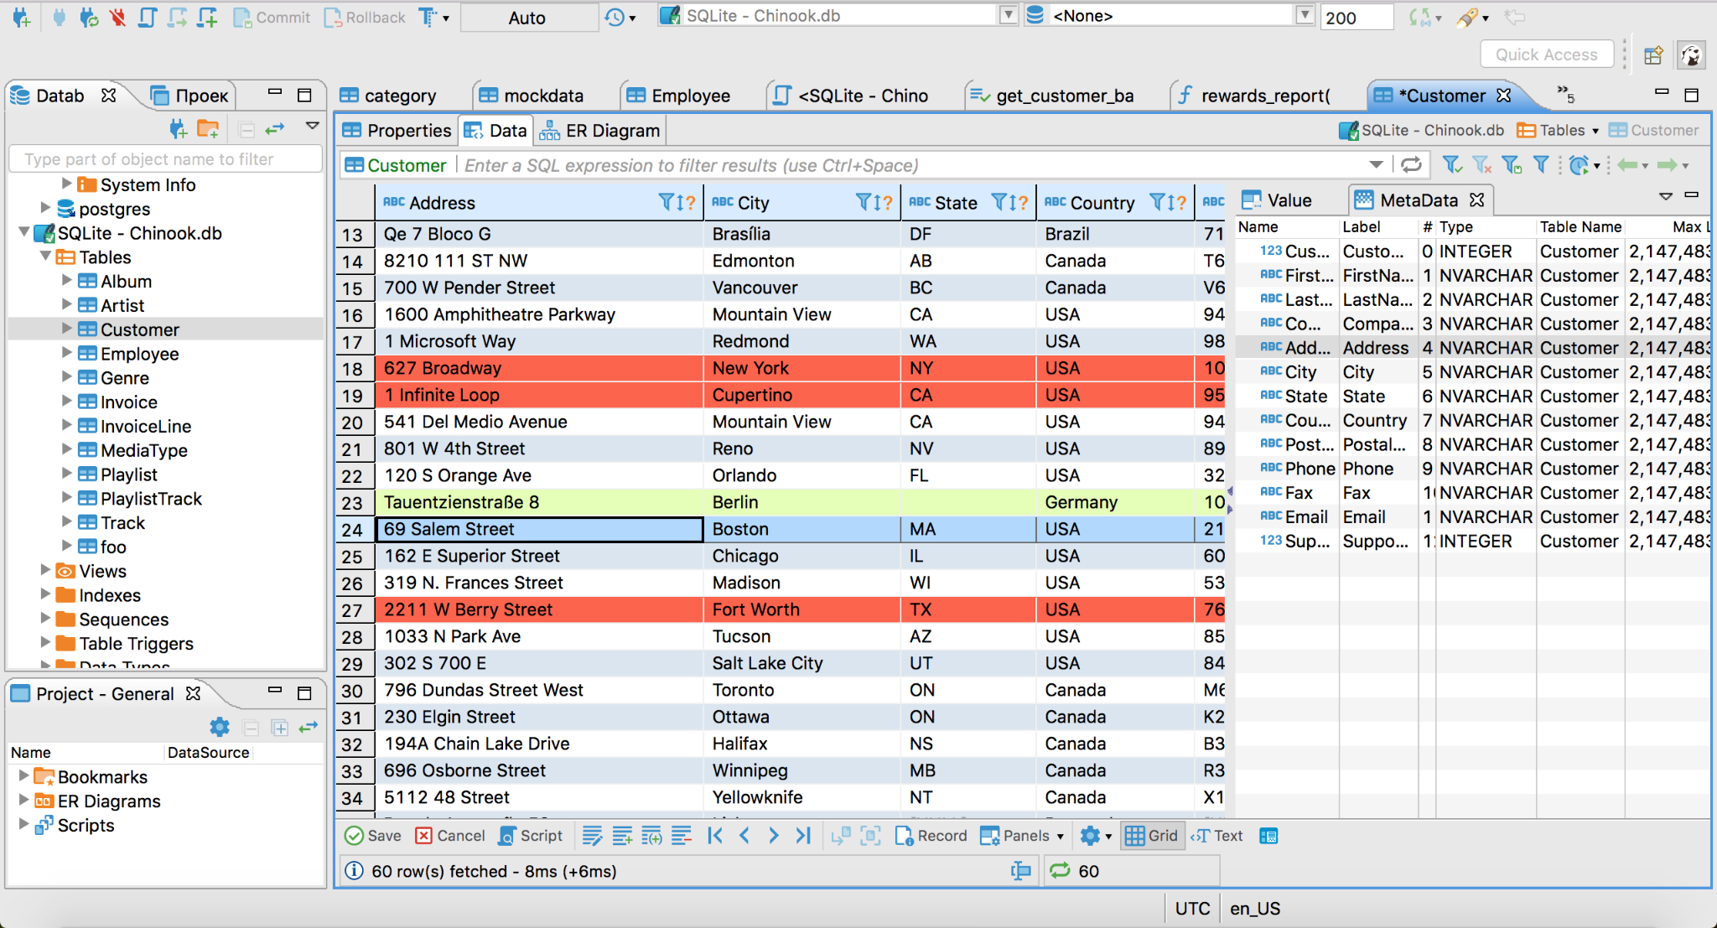
SQLite
SQLite is a C-language library that implements a small, fast, self-contained, high-reliability, full-featured, SQL database engine
SQLite has many RDBMS to interact with like dbeaver and SQLiteStudio
Why using SQLite?
Serverless
Self-contained
Zero-configuration
Transactional
Notes:
Atomic, Consistent, Isolated, and Durable.
The screenshot is of the beaver RDBMS

Slide 15

What is the difference between Declarative and Procedural programming languages
Notes:
Declarative: What I want to have
Procedural: How do I want to have it

Slide 16


Slide 17
SQLite
Practical example (Learning by doing)

Slide 18
Data Types in SQLite
Relational databases are about storing data in homogeneous tables Each column in each table has a defined type
Types are specific for each RDBM system. SQLite is very minimalistic:
INTEGER - store integer values (e.g.: -5, 10, 0, 232, etc.) (1B, 2B, 3B, 4B, 6B, 8B)
REAL - store a floating-point value (e.g: 2.37, -1.33, 23.0, etc.) (8B IEEE)
TEXT - text string stored using database encoding (UTF-8, UTF-16BE, UTF-16LE)
BLOB - raw data stored exactly as inputted (think of this as raw bytes)
SQLite misses two important data types:
BOOLEAN - can be stored as an integer (1 - TRUE, 0 - FALSE)
DATE & TIME - we will need to look into creative alternatives later on
Notes:
Tell about using unix timestamp

Slide 19
The power of NULL
When defining a column, it is possible to define if it is nullable or not Nullable columns allow “NULL” values to be stored
What is NULL?
It is meant to indicate the absence of a value for a specific field
Most RDBM systems treat it as a special value
It is not the same with 0, “”, “NULL”, 0.00 or other ‘equivalent’ values
Requires special syntax to operate with (keep in mind for now!)
Be careful - when inserting a new row, you must always specify a value for non-nullable columns (or take advantage of DEFAULT values)

Slide 20
CRUD - The four basic operations
Whether operating on an API’s resources or a Database table’s rows, there are four main operations that need to be well understood:
Create (INSERT) - add new entries/rows
Read (SELECT) - retrieve data from existing entries/rows (based on some parameters, conditions etc.)
Update (UPDATE) - Alter data of one or more existing entries/rows
Delete (DELETE) - Delete one or more entries/rows

Slide 21
SQL Create table
Create a table
CREATE TABLE IF NOT EXISTS books ( id integer PRIMARY KEY, name text NOT NULL, author_id integer NOT_NULL, FOREIGN KEY (author_id) REFERENCES authors (id) );

Slide 22
SQL INSERT
NOTE:
Column names are not mandatory, but they improve clarity and allow ordering the inserted data (as well as omitting optional columns)
Add entries to a table
INSERT INTO Books (Year, Title, Author) VALUES (1844, ‘The Three Musketeers’, ‘Alexandre Dumas’,), (1960, ‘To Kill a Mockingbird’, ‘Harper Lee’), (1960, ‘A Passage to India’, ‘E.M. Forster’, 1924)

Slide 23
SQL SELECT
--this is a comment SELECT * FROM Books --star (*) operator stands for all columns SELECT Title, Author, Year FROM Books --or specify the columns SELECT DISTINCT Title FROM Books --distinct removes duplicate projected rows

Slide 24
SQL WHERE
We can also filter target rows based on a condition. For this we use the WHERE operator
SELECT Title, Author FROM Books --all books since 1998 WHERE Year >= 1998 --simple boolean conditions work SELECT Title, Author FROM Books --all books after 1999 and until 2012 WHERE Year > 1999 AND Year <= 2012 --use AND/OR for more complex conditions SELECT Title, Author FROM Books --all books with title starting with “Harry” WHERE Title LIKE “Harry%” --% wildcard in LIKE matches anything SELECT Title, Author FROM Books --get all books from 2000, 2002, 2004 and 2006 WHERE Year IN (2000, 2002, 2004, 2006) --NOT IN is also possible SELECT Title, Author FROM Books --get all books without a Year but with an Auth. WHERE Year IS NULL AND Author IS NOT NULL --comparisons with NULL are always false

Slide 25
SQL UPDATE
We can also update existing entries.
UPDATE Books --update the name of a specific author for all books SET Author = ‘Edward Morgan Forster’ WHERE Author = ‘E.M. Forster’ UPDATE Books --add a stock of 5 copies for all books SET Stock = Stock + 5 --it will take the current value for each row before update UPDATE Books --the two can also be combined SET Stock = Stock + 10 WHERE Title LIKE ‘_arry Potter%’ --underscore wildcard matches any one character

Slide 26

Before you go…
Please take 2 minutes to give us feedback on today’s lesson.
This feedback is anonymous and only seen by the DCP team!
Scan the QR code or go to: https://redischool.typeform.com/lessonfeedback

